Slide 1
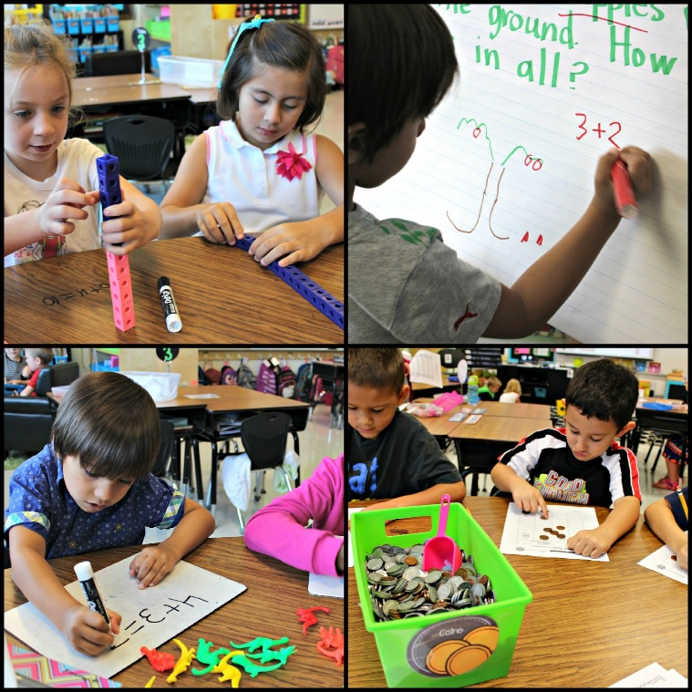
Just-In-Time
Direct Instruction

Slide 3
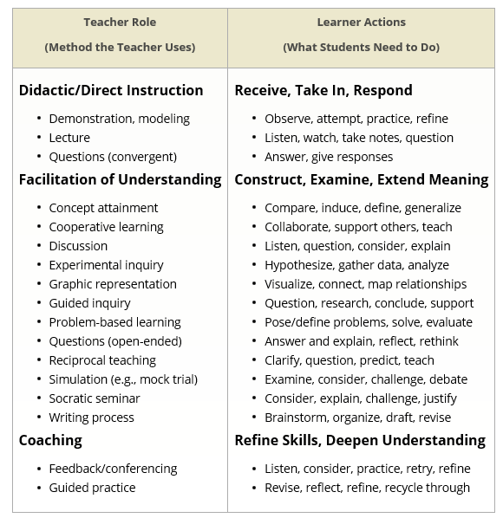

Slide 4
Key Components of Just-In-Time Direct Instruction
Student get only direct instruction that they need
Students get support WHEN they need it.
Provide “just-in-time” instruction in small, focused doses.
Students are guided toward making their own learning decision.

Slide 5
Just-in-time teaching means we do not frontload lots of content out of context—what might be called “just-in-case” teaching
Some concepts and knowledge we teach do not need to go through the process of direct, guided, then hands-on. We can begin with discovery (hands-on/minds-on) followed with checking for understanding, then direct and guided instruction for those who need further support. (Tools for Teaching: How to Transform Direct Instruction, Rebecca Alber)

Slide 6
Just-in-time teaching means, rather, that we implement direct teaching when it is needed and when learners are ready for it. It is important that we first "diagnose" where are students' are in their understanding and application of the specific knowledge/concept we are about to teach. Then determine the best instructional approach. (Tools for Teaching: How to Transform Direct Instruction, Rebecca Alber)

Slide 7
There are times when direct instruction
serves the goal of understanding.
A common misconception regarding “constructivist” theories of knowing is that teachers should never tell students anything directly, but instead should always allow them to construct knowledge for themselves. This perspective confuses a theory of pedagogy (teaching) with a theory of knowing. . . . There are times, usually after people have first grappled with issues on their own, that “teaching by telling” can work extremely well. (Bransford et al., 2000, p. 11) (emphasis added)

Slide 8
How Can We Make This Work?
On-going assessment
Grouping based on needs
Use of digital tools to facilitate

Slide 9
Adjust plans in light of unexpected or inappropriate results
Do not to assume that learning is occurring, based on the teaching.
Ensure that learning occurs, and when it doesn't, to intervene decisively, quickly, and often
Regularly assess and learn from the results as quickly as possible so as to make the necessary adjustments to improve learning.

Slide 10
A Good Facilitator:
Provides Meaningful tasks and projects
Guides to Resources
Questions

Slide 11
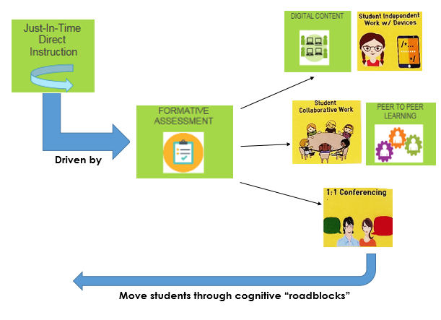
Provide enrichment & guided practice as needed

Slide 12
Implement Just-In-Time Direct Instruction

Slide 13
Formative Assessment Lessons

Slide 14
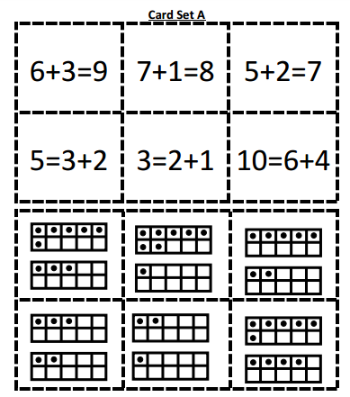
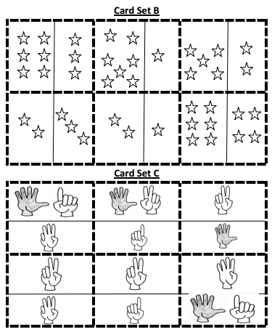
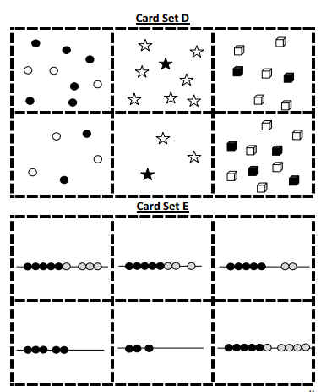
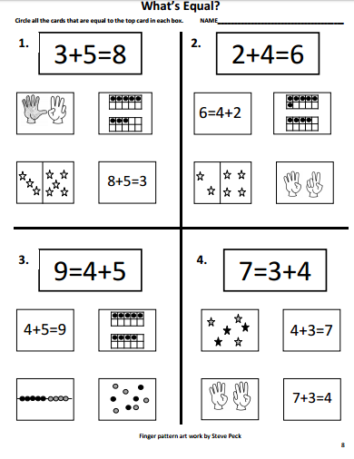
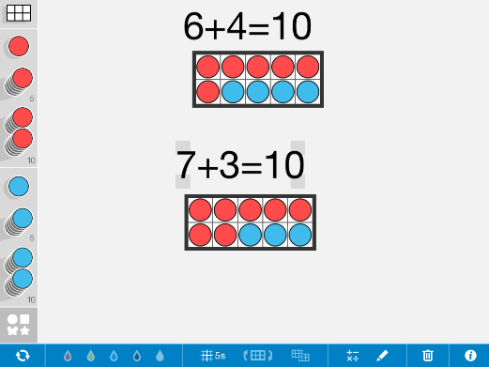
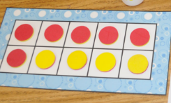
Kindergarten
Number Pieces APP

Slide 15
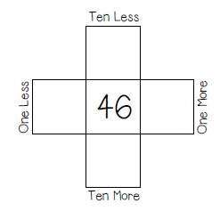
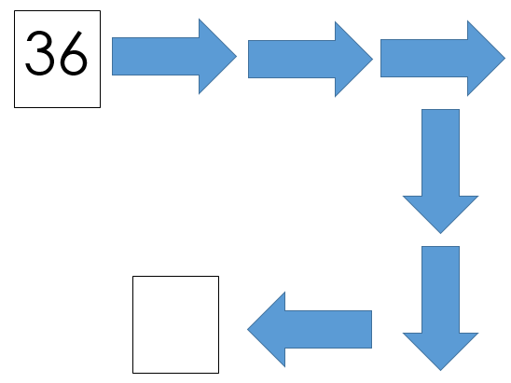
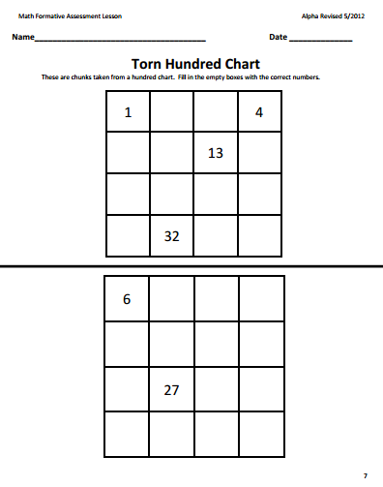
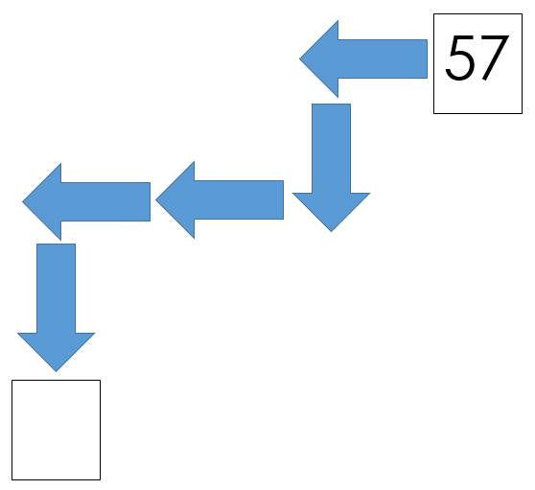
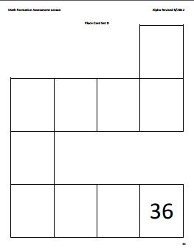
1st Grade
Record Explanations with…

Slide 16
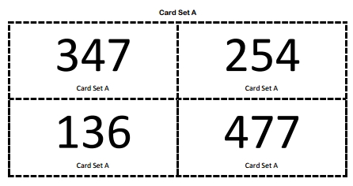
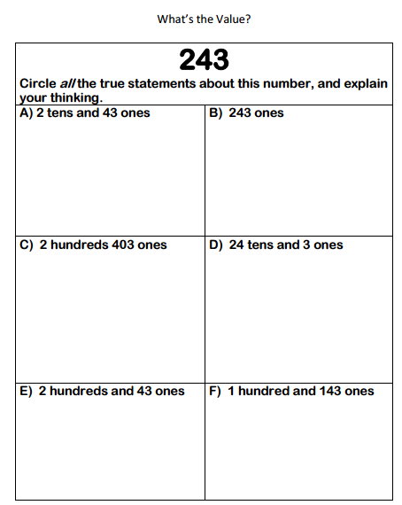
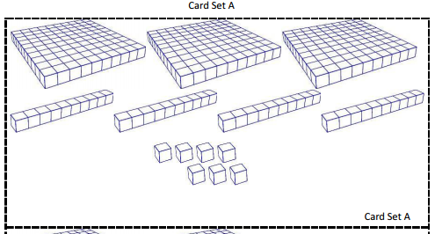
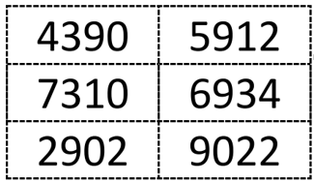
2nd Grade
If Numbers Could Talk

Slide 17
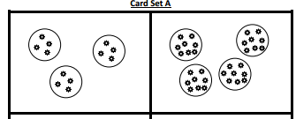
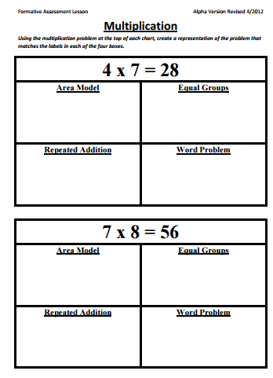
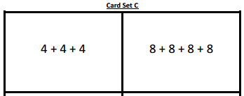
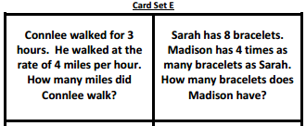
3rd Grade

Slide 18
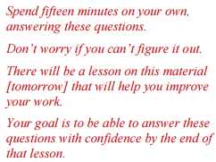
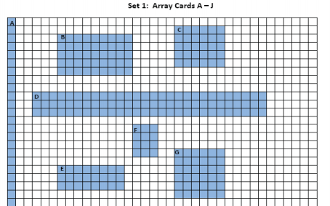
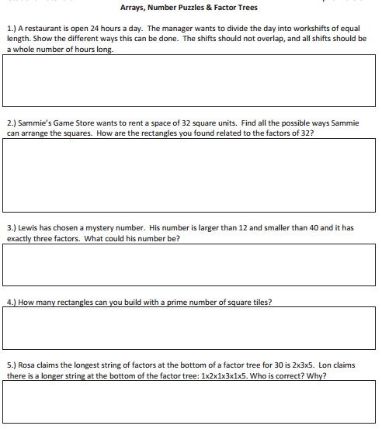
4th Grade

Slide 19
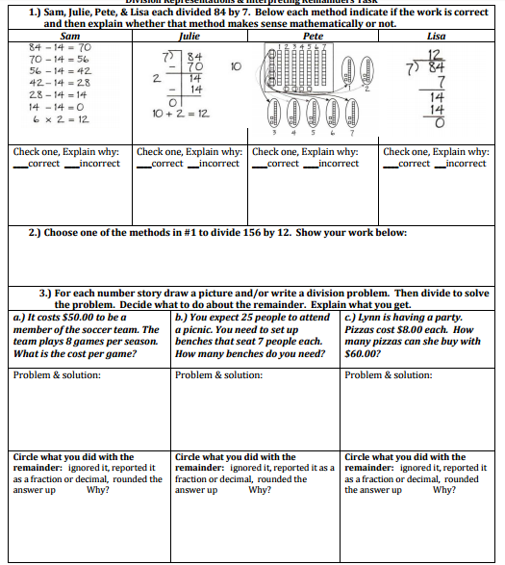
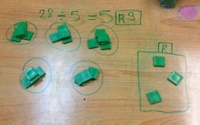
5th Grade

Slide 20
Formative Assessments with Technology

Slide 21
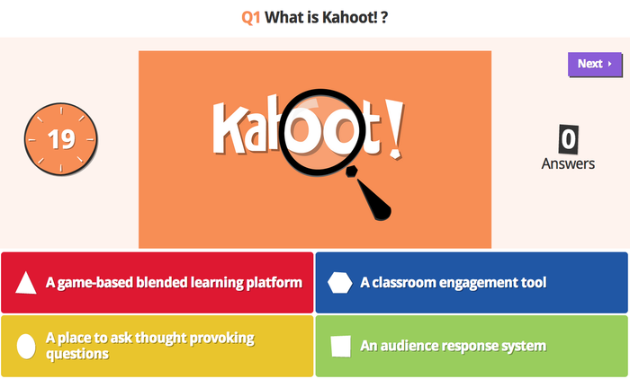

Slide 23
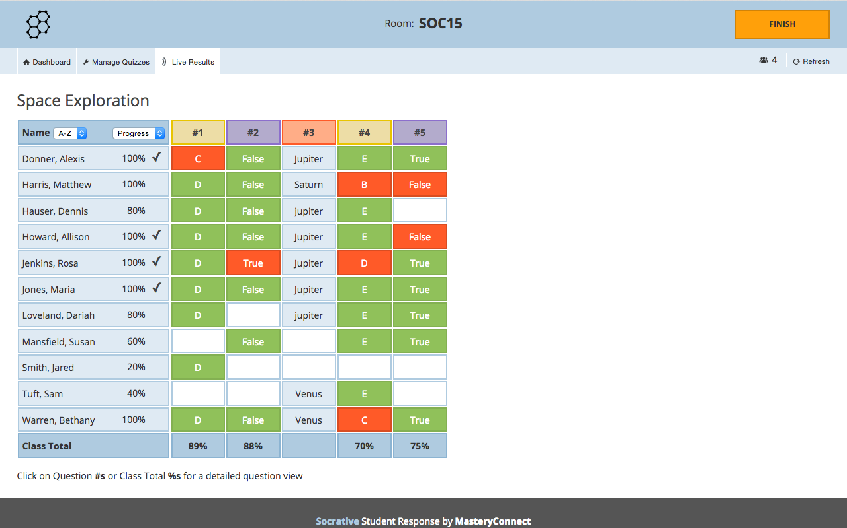
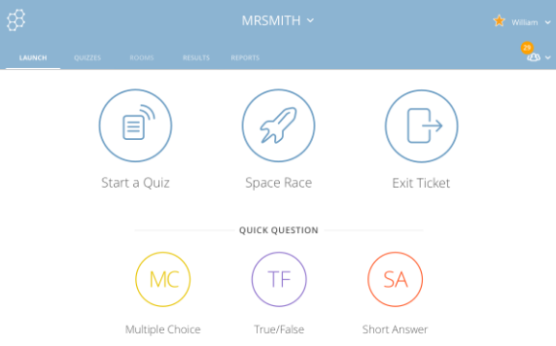

Slide 24
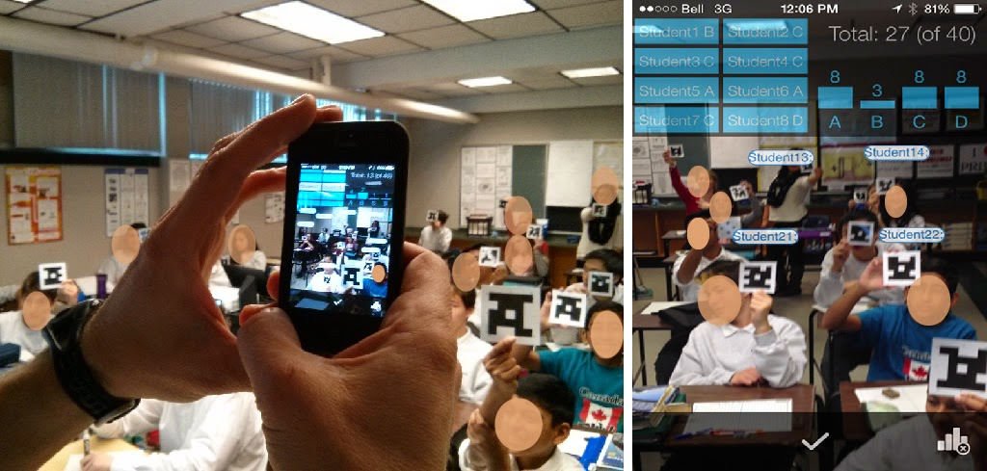
Formative Assessments with Technology

Slide 25
Flipped Classroom Lessons

Slide 26
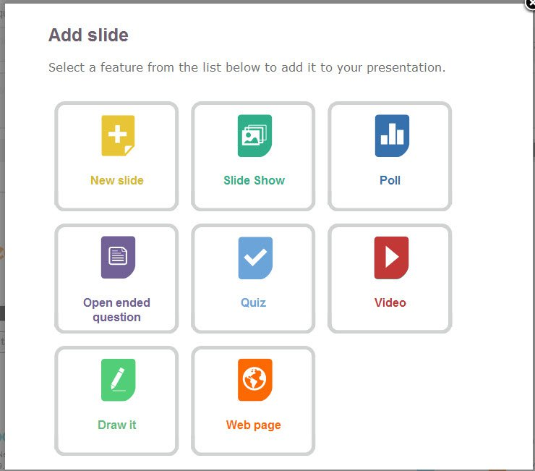
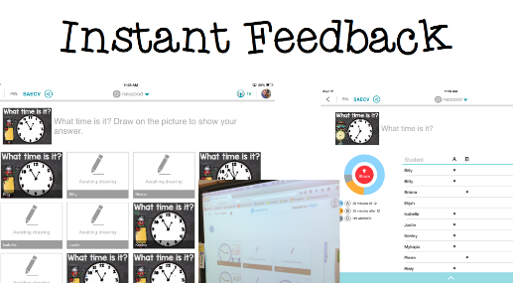

Slide 27
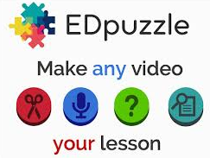

Slide 28
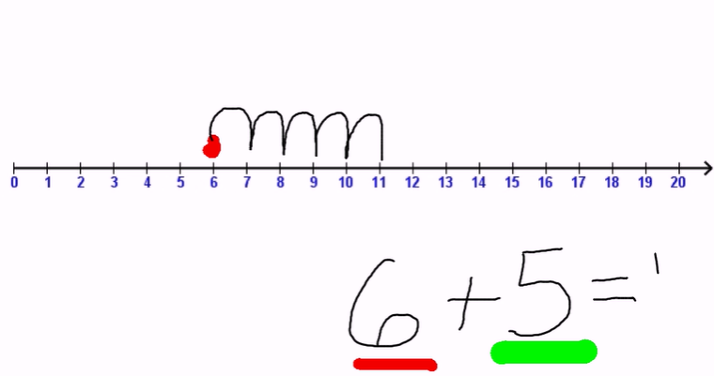
Examples

Slide 29
Just-In-Time Direct Instruction in Project Based Learning (PBL)

Slide 32
Sources
Schooling by Design by Grant Wiggins and Jay McTighe, ACSD
http://www.ascd.org/publications/books/107018/chapters/What-Is-the-Teacher's-Job-When-Teaching%C2%A2.aspx
Tools for Teaching: How to Transform Direct Instruction Rebecca Alberby
https://www.edutopia.org/blog/tools-for-teaching-transform-direct-instruction-constructivism-rebecca-alber
Teaching Strategies: Direct Instruction http://www.d.umn.edu/~hrallis/courses/3204fa04/planning/instr_strats.htm
K-5 Formative Assessment Lessons (FALs)
https://ccgpsmathematicsk5.wikispaces.com/K5+Formative+Assessment+Lessons+(FALs)

